Slide 1
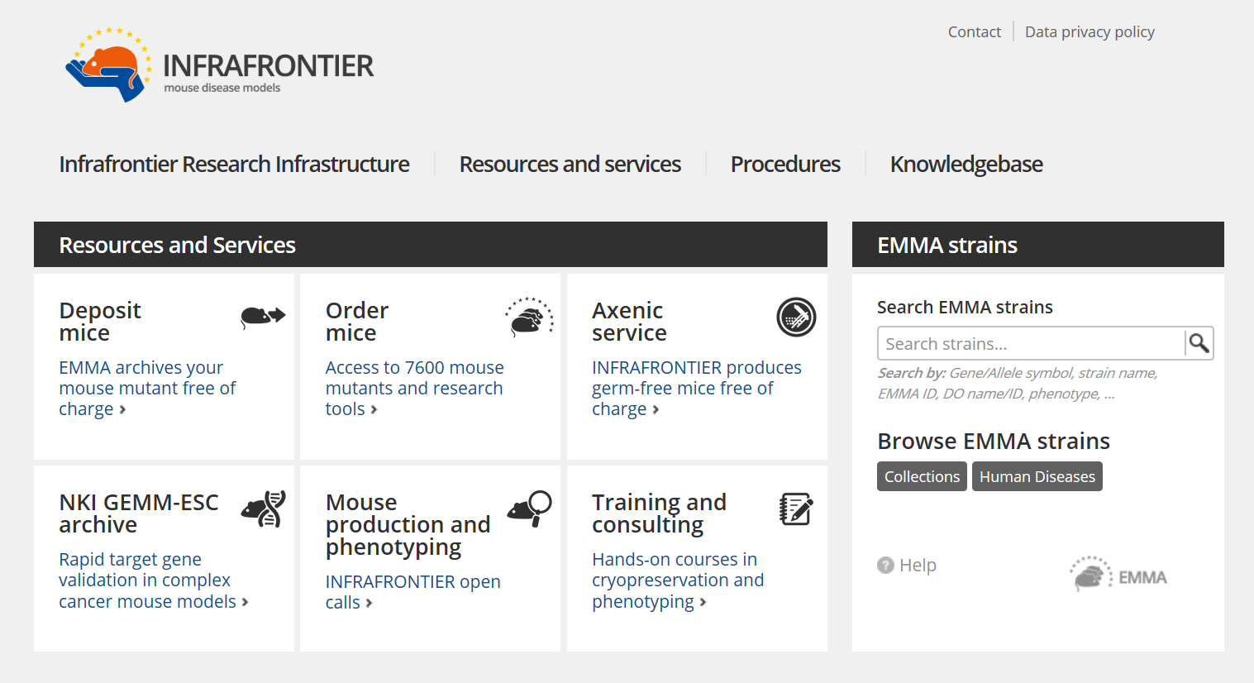
PREMOS
Goal: increase translational value of preclinical models in neuropsychiatry
INFRAFRONTIER + PRISM + EQIPD join forces
www.ebra.eu/premos
Coordinator: PD Dr. Sabine Hölter-Koch
Co-Coordinator: Dr. Yann Herault

Slide 2
www.infrafrontier.eu

Slide 3
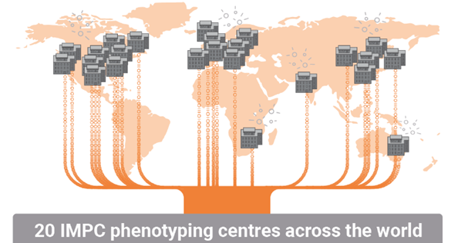
Conserved disease-relevant biological mechanisms?
Mutant mouse line for every gene with a human orthologue (7824 to date)
Neurobiology-based, validated in-vivo read-outs
Whole body phenotyping – strategically placed to identify genetic relation between psychiatric and shared medical comorbidities.
Single genetic background – small effects become detectable
Advantageous for rare disrupting mutations with limited patient cohorts

Slide 4
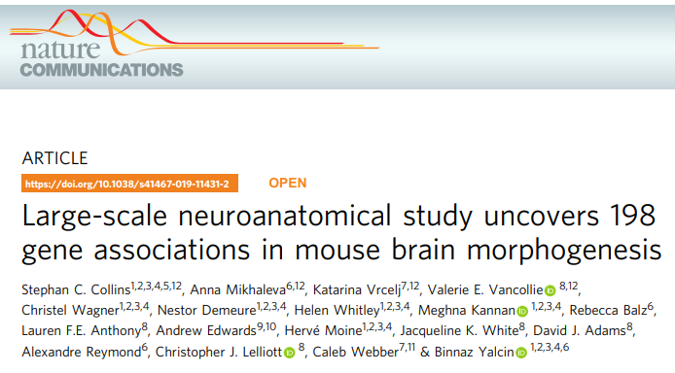
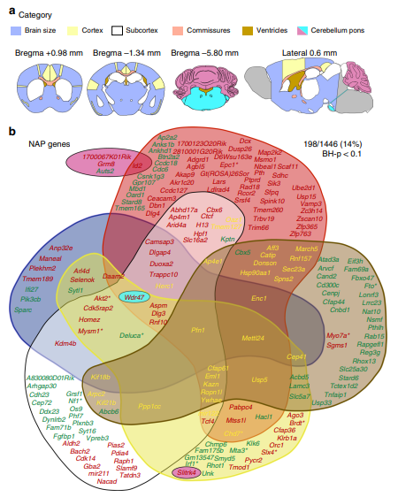
Conserved disease-relevant biological mechanisms?
118 neuroanatomical parameters analysed in 1566 mutant mouse lines (males only)
17% of human unique orthologues of mouse neuroanatomical phenotype genes are known loci for cognitive dysfunction

Slide 5
IMI PRISM² Project
Project coordinator: Prof. Dr. Martien Kas, Groningen University
Project leader: Dr. Hugh Marston, Boehringer Ingelheim
www.prism2-project.eu

Slide 6
PRISM implemented homologous quantitative biological parameters in clinical and preclinical studies
Focus on domains that are affected trans-diagnostically
PRISM will back-translate human findings in animal studies to develop predictive model systems as an important step to validate underlying mechanistic concepts and for future testing of therapeutic approaches
www.prism2-project.eu

Slide 7
www.prism2-project.eu

Slide 8
IMI EQIPD Project
Project coordinator: Prof. Malcolm MacLeod, Edinburgh University
Project leader: Dr. Thomas Steckler, Janssen Pharmaceutica

Slide 9
Irreproducibility - Many Things can Go Wrong
Use of non-authenticated materials / unvalidated assays
Inappropriate controls / baseline
Wrong experimental unit
Inadequate choice of sample size / inadequately powered study
Lack of prespecified in- and exclusion criteria / start- and endpoints
Lack of prespecified (primary) outcome measure(s)
Lack of / inappropriate randomization of sample allocation
Lack of / inappropriate concealment of treatment allocation
Lack of / inadequate blinding of outcome assessment
Outlier removal without prespecified outlier criteria
Inappropriate statistical analysis
Small, meaningless effect size
Frank errors (dosing, copy-paste,…)
Misleading data presentation
Selected reporting of results
Hypothesizing after the results are known (HARKing)
Falsified data
Inappropriate study documentation
Inappropriate data storage and lack of traceability

Slide 10
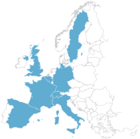
Enhancing Quality In Preclinical Data
Objectives
Create simple, sustainable solutions that facilitate improvements in non-clinical data quality without impacting innovation and freedom of research
Start: 01.10.2017
3 years + 1 year no-cost extension
Project budget: 9.8 mio €
Strategic fit with PREMOS
Enhanced predictive validity, better reproducibility and translatability of animal models due to strengthened rigor / internal validity of non-clinical studies
To build trust in non-clinical data and improve decision making
IMI + other funding: 4.8 mio €
EFPIA in-kind: 5.1 mio €
Consortium:
Outcome & value proposition
Implementation of the EQIPD Quality System
Generation of more robust and reliable internal and external non-clinical data
Released Oct 2020
Utilization of the EQIPD online Training Platform
Training of internal scientists and external collaborators on GRP
Under construction
Israel
Partners Coordinators
10 Public University of Edinburgh
12 EFPIA Janssen Pharmaceutica
8 SMEs
5 associated collaborators
~100 stakeholders
Partnering
Close interaction with Infrafrontier and PRISM to generate a unified view on the way forward

Slide 11
Objectives
Reach a broad consensus on a strategy to improve the predictive value of preclinical models in neuropsychiatric research involving all stakeholders
Reduction of the number of animals needed in preclinical research
Cellular systems and organoids can not model complex behaviors or the entire physiology of a living organism, nor can they be simulated
Regulators still insist on preclinical in-vivo studies in model organisms

Slide 12
Activities
Start: 1. February 2021; End: October 2022
Survey of main translational gaps among cluster members
Discussion in 3 WG meetings about:
Requirements for clinical relevance of model systems
To treat a disease, we need to understand the mechanism in a complex organism
We need to ensure investigation of biologically conserved disease-relevant mechanisms
Preclinical data quality measures need to be implemented on a large scale
Stakeholder meeting (virtual): February/March 2022
Consensus meeting (in Brussels): ? 2022
ebra@braincouncil.eu

